Slide 1
Poisson Distribution
Prepared by
Sajana Shakya

Slide 2
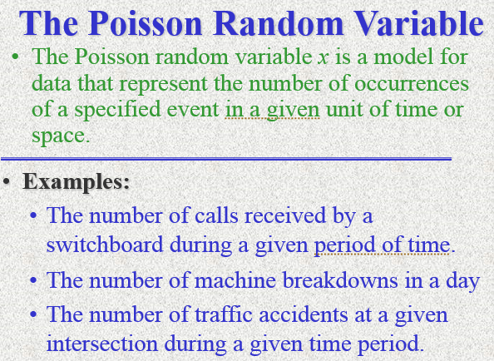

Slide 3
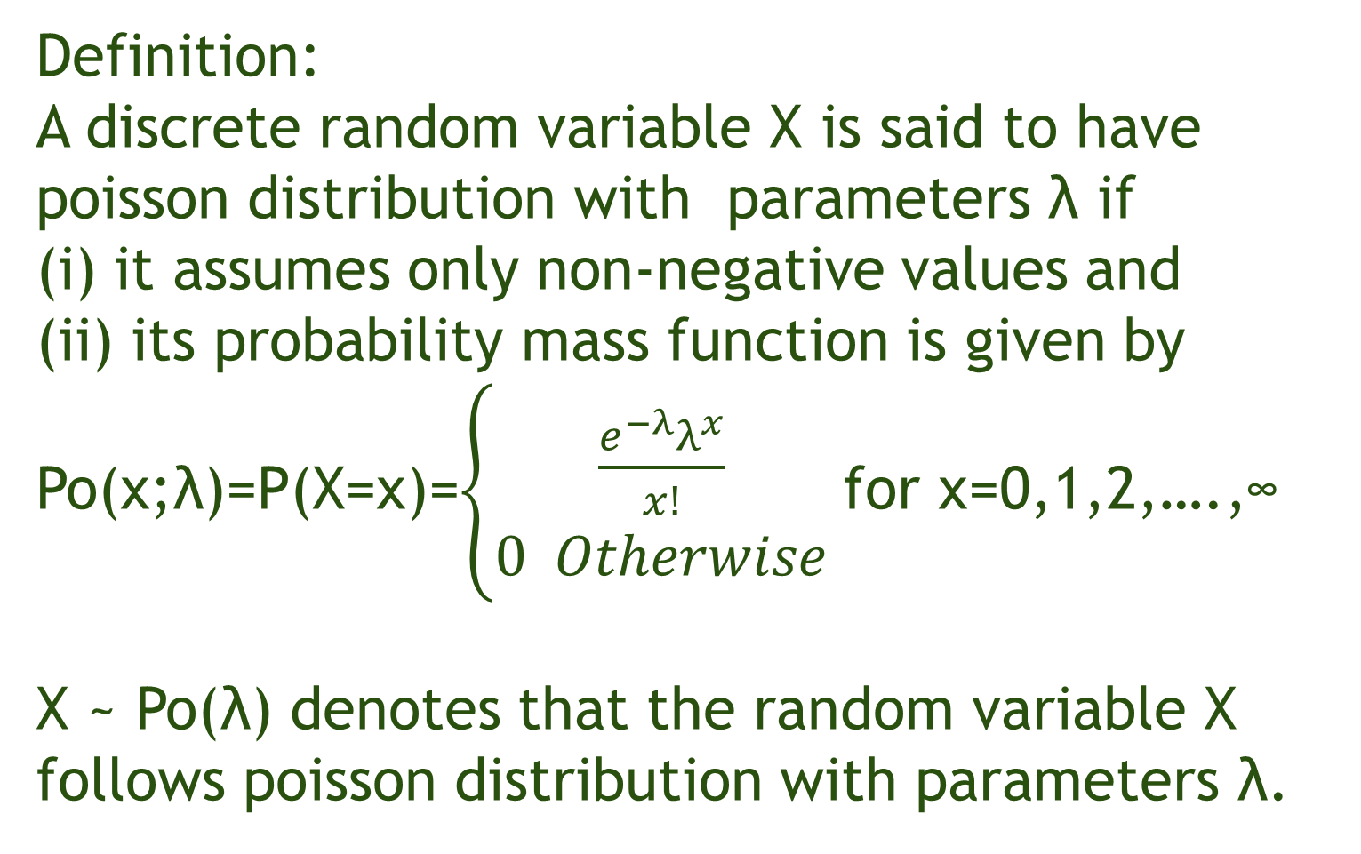
Definition:
A discrete random variable X is said to have poisson distribution with parameters λ if
(i) it assumes only non-negative values and
(ii) its probability mass function is given by
Po(x;λ)=P(X=x)=$\left\{\begin{aligned}\frac{e^{−λ}λ^{x}}{x!} \\ 0 Otherwise\end{aligned}\right.$ for x=0,1,2,….,∞
X ~ Po(λ) denotes that the random variable X follows poisson distribution with parameters λ.

Slide 4
Properties:
It is uniparametric distribution.
It is discrete probability distribution. and assumes only non-negative values i.e. 0,1,2,3,……….,∞
The average number of occurrences in given interval of time or space should be known in advance.
The mean and variance of poisson distribution is equal to λ.
E(x)=λ and V(x)=λ
It is positively skewed distribution. It tends to normal distribution when λ is very large.

Slide 5
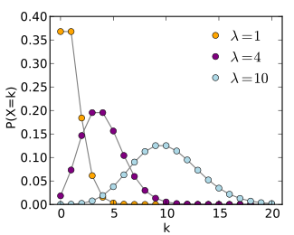
Properties:
The number of occurrences in any time interval is independent of number of occurrences in any other interval.
The probability that two or more successes will occur is virtually zero when time interval is very small.

Slide 6
The poisson distribution as an approximation to Binomial distribution:
Let x be a discrete distribution which represents number of successes in n repeated Bernoulli trials.
X ~ B(n,p), E(x) = np V(x)= npq
The number of trials is indefinitely large , i.e. n -> ∞
The probability of success for each trial is indefinitely small, i.e. p -> 0
np = λ is finite

Slide 7
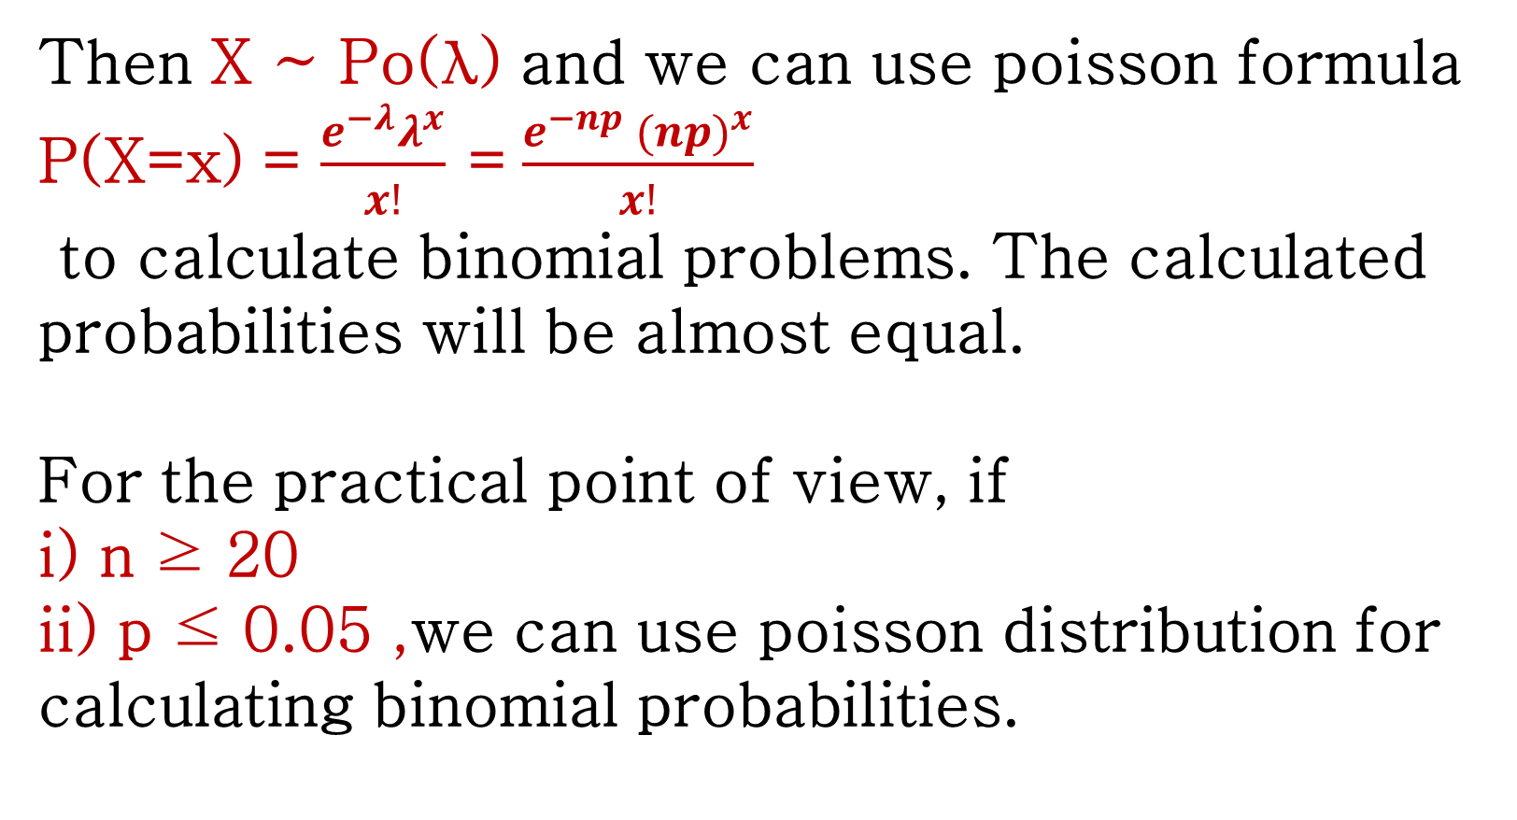
Then X ~ Po(λ) and we can use poisson formula P(X=x) = $\frac{e^{−λ}λ^{x}}{x!}$ = $\frac{e^{−np}{ (np)}^{x}}{x!}$ to calculate binomial problems. The calculated probabilities will be almost equal.
For the practical point of view, if i) n ≥ 20 ii) p ≤ 0.05 ,we can use poisson distribution for calculating binomial probabilities.

Slide 8
Problem 1:
An office switchboard receives telephone calls at a rate of 3 calls per minute on an average. Find the probability of receiving
(i) no calls in one-minute interval;
(ii) at most 2 calls in a five-minute interval.

Slide 9
Problem 2:
A typist made 2.8 mistakes on an average per page. Find the probability that in the page typed by him,
(i) there is no mistake,
(ii) there are two or less mistakes
(iii) more than 10 mistakes.

Slide 10
Problem 3:
In a certain factory turning out razor blades, there is a small chance 1/500 for any blade to be defective. The blades are supplied in a packet of 10. use poisson distribution to calculate the approximate number of packets containing one defective, two defective and 3 defective blades, in a consignment of 10,000 packets.

Slide 11
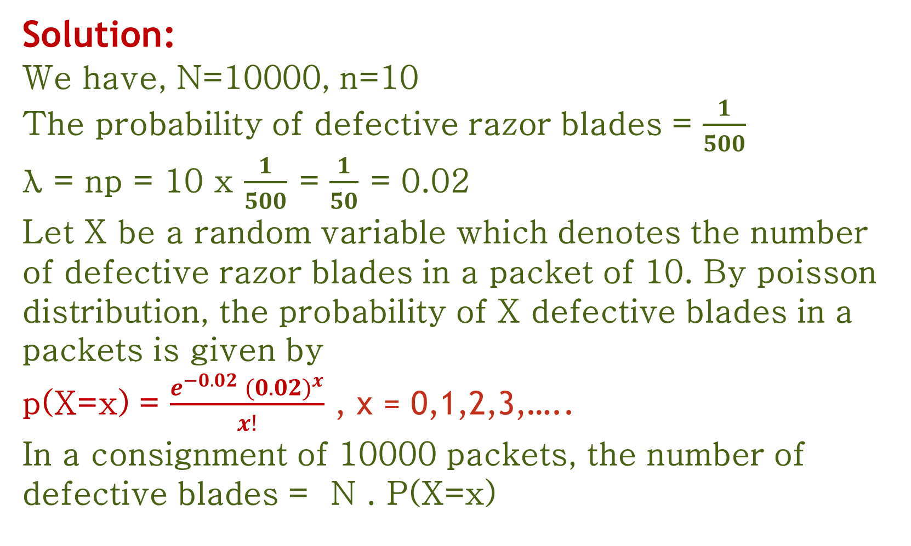
Solution:
We have, N=10000, n=10
The probability of defective razor blades = $\frac{1}{500}$ λ = np = 10 x $\frac{1}{500}$ = $\frac{1}{50}$ = 0.02
Let X be a random variable which denotes the number of defective razor blades in a packet of 10. By poisson distribution, the probability of X defective blades in a packets is given by p(X=x) = $\frac{e^{−0.02}{ (0.02)}^{x}}{x!}$ , x = 0,1,2,3,…..
In a consignment of 10000 packets, the number of defective blades = N . P(X=x)

Slide 12
Problem 4:
If 2% of the electric bulbs manufactured by a company are defective, use poisson distribution to find the probability that in a sample of 200 bulbs
(i) non is defective
(ii) more than 3 bulbs will be defective.

